Slide 1



Slide 2



Slide 3



Slide 4




Slide 5
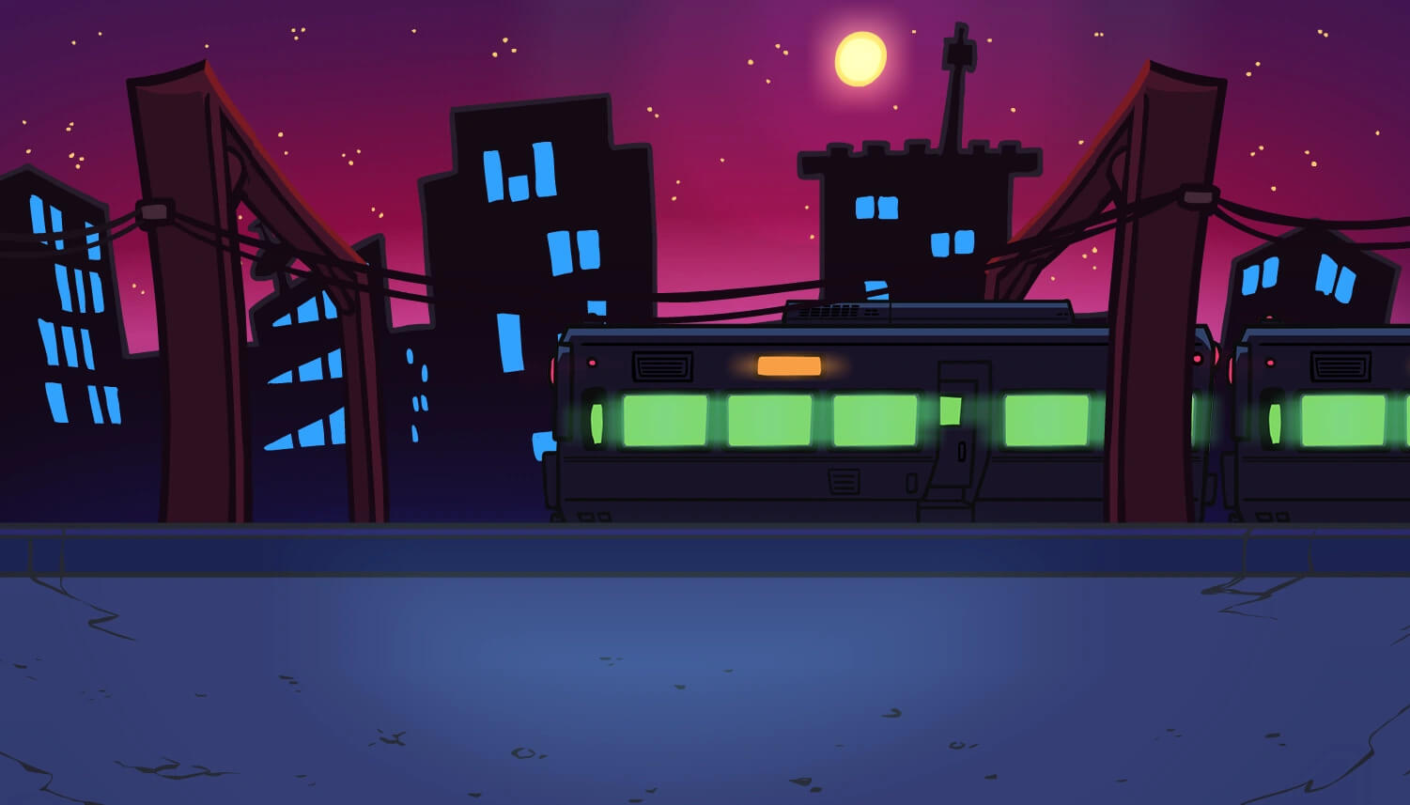


Slide 6
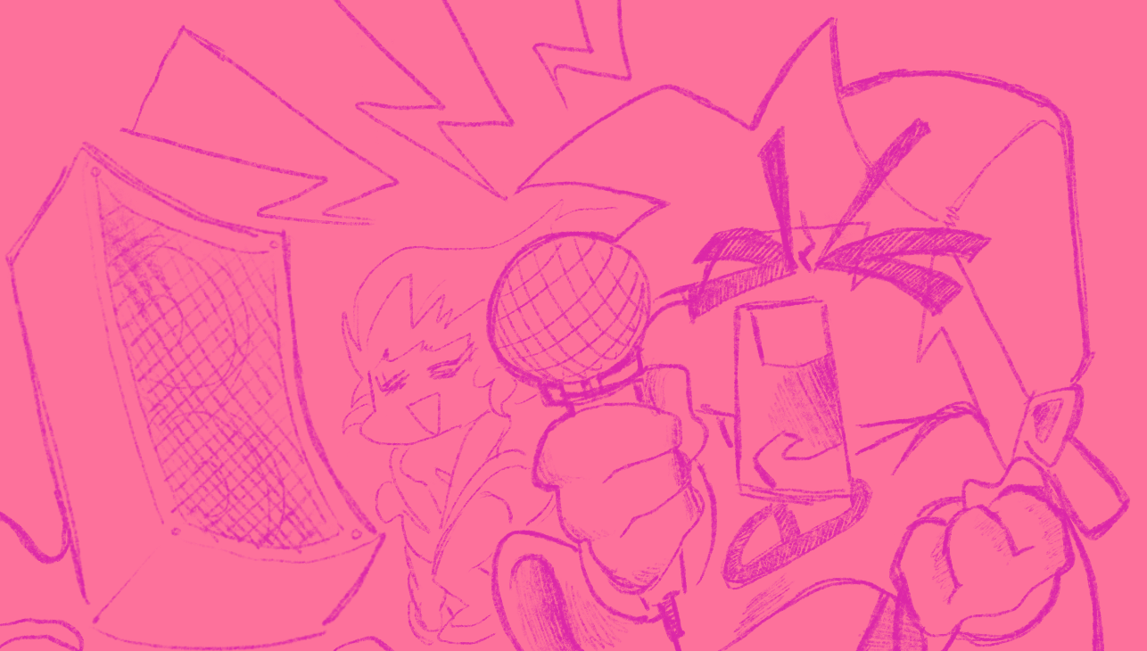




Joalor64 Engine 1.0.0

Slide 7
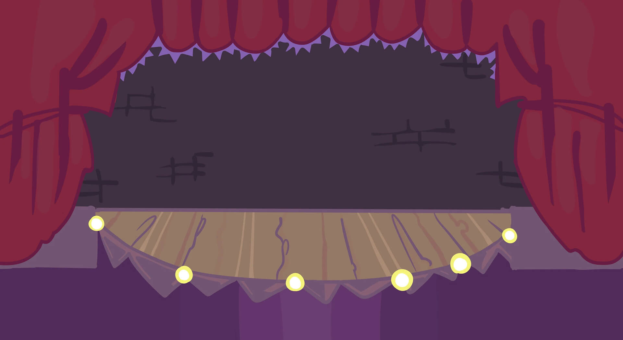
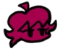

NPS: 0 | Score: 0 (0) | Misses: 0 | Health: 50% | Accuracy: 100.00% | Ranking: Perfect!!
Bopeebo - Hard | JE 1.0.0

Slide 8
Perfect!!
SFC (AAAAA)
MFC (AAAA)
GFC (AAA)
FC (AA)
SDCB
CB
A
B
Clear
C D
Epic!!
Nice!
Okay…
Bruh
Icon template
lose
normal
win
0 1 2 3 4 5 6 7 8 9 - .

